Slide 1


Slide 2
Always remember:
No one is born with a keyboard in their hand; It’s only human to make mistakes;
and There are no dumb questions.

Slide 3
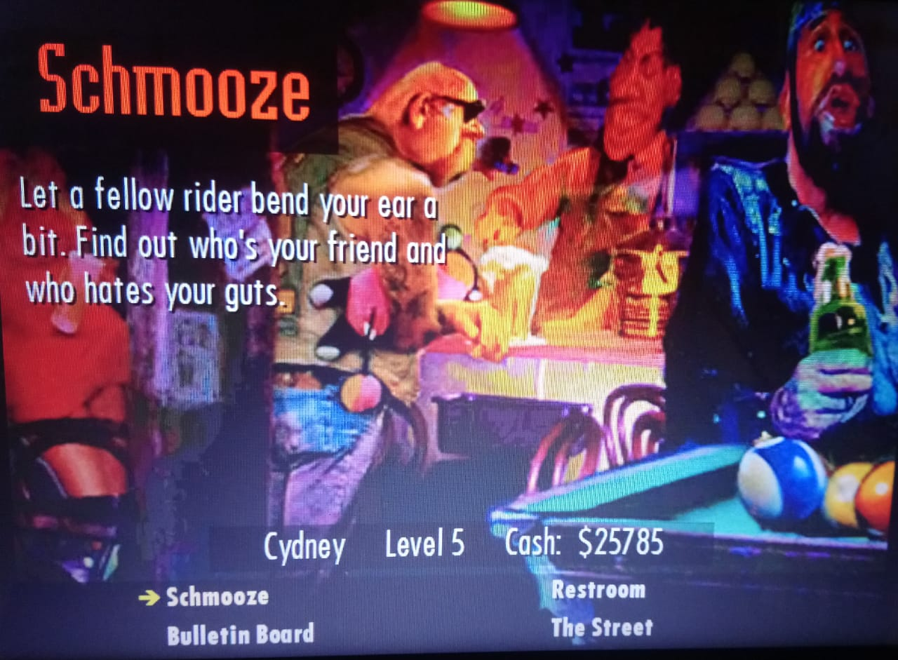

Slide 4
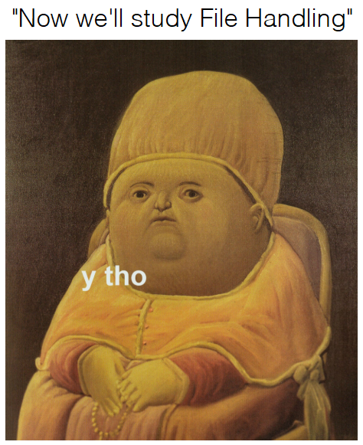

Slide 5
Difference between Streams and Files
Programmer (user)
Stream (Interface)
Device (File)
FILE: Device ON which an action is to be performed; may be anything.
STREAM: Interface BETWEEN the user and the said device; independent of the device being accessed.

Slide 6
Directory Structure
Organisation
Path
Directories/Volumes

Slide 7
write
read
lstrip
rstip
with
Functions for File Handling
split
open
close
seek
tell

Slide 8
getcwd
mkdir
Directory-related functions
rmdir
chdir

Slide 9


Slide 10
open()
objectName = open(fileName, mode);

Slide 11
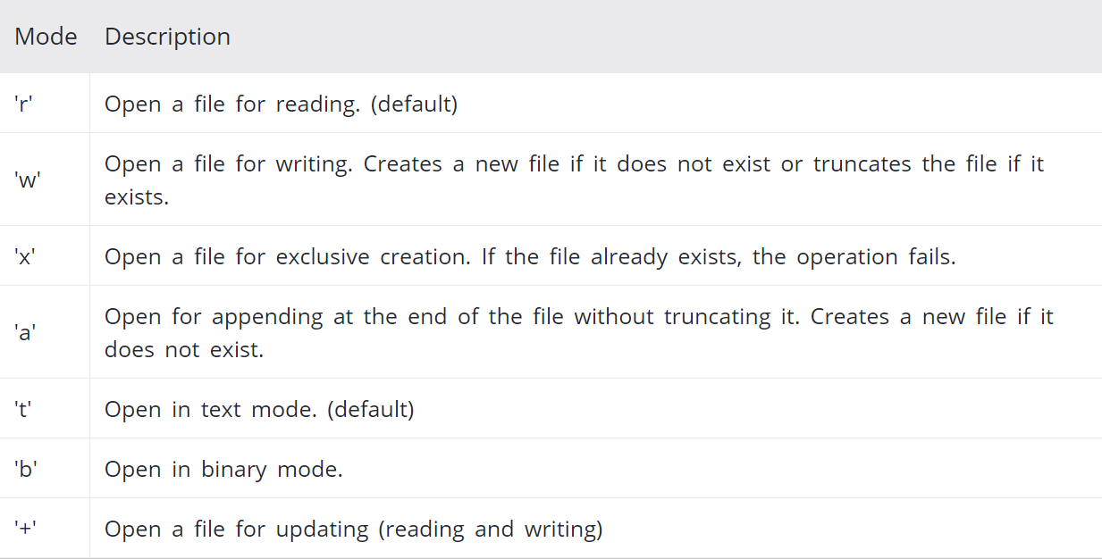
Modes

Slide 13
someAction()
objectName.someAction()

Slide 14
Where
someAction can be:
close read readLine write

Slide 15


Slide 16
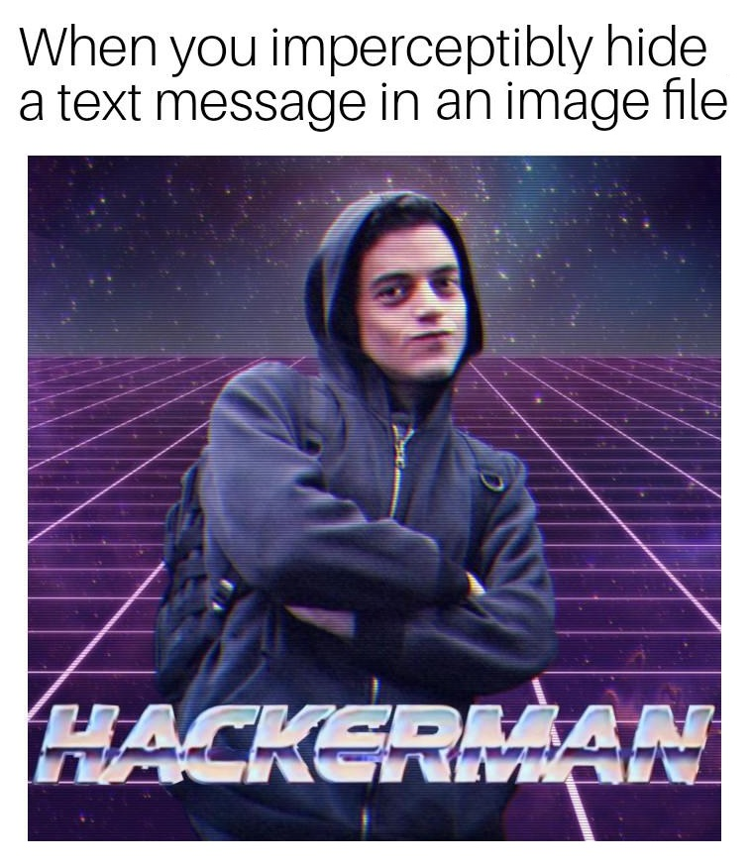

Slide 17
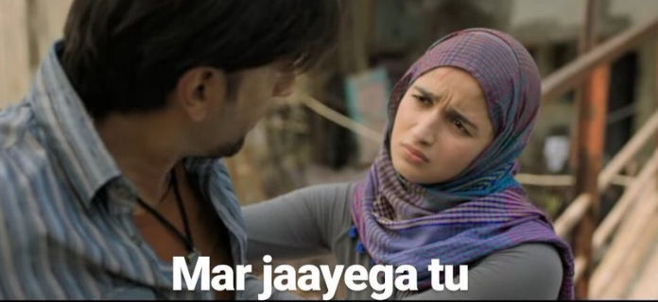

Slide 19
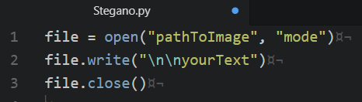

Slide 20
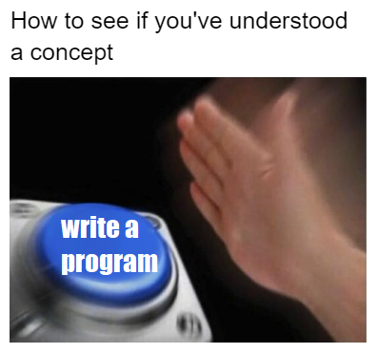

Slide 21
Now try something that you do everyday (slides 22-24):
Make a simple text file using Python, named YOUR_ASSIGNMENT.txt. (Hint: it is a new text file, and you will write to the file.)

Slide 22
Write characters in the file (can be anything)
Now, we want to copy the contents of YOUR_ASSIGNMENT.txt to another file called MY_ASSIGNMENT.txt.
As is obvious, you’ll have to create YOUR_ASSIGNMENT.txt.
(Hint: To copy, YOUR_ASSIGNMENT.txt shall be opened in input mode, and writing to MY_ASSIGNMENT.txt will require it to be opened in output mode)
(Ask us if you still have any doubts)

Slide 23
Open MY_ASSIGNMENT.txt and display its contents.
Check if YOUR_ASSIGNMENT.txt has been copied correctly.

Slide 24
The answer for the question mentioned in slides 22-24 is given in the file named SampleProgram.py.
(If your code differs, as long as the basic aim of the aim of question is addressed you don’t need to worry.)

Slide 25
These are some sites that had been referred to for this topic:
Read further if you’re interested.
If you aren’t, don’t ¯\_(ツ)_/¯
(I hope) you now know whatever basics you need to.
https://www.w3schools.com/python/python_file_open.asp
https://www.geeksforgeeks.org/file-handling-python/
https://www.tutorialspoint.com/python/python_files_io.htm
https://www.programiz.com/python-programming/file-operation
https://www.pythonforbeginners.com/files/reading-and-writing-files-in-python
https://www.pythonforbeginners.com/cheatsheet/python-file-handling

Slide 26
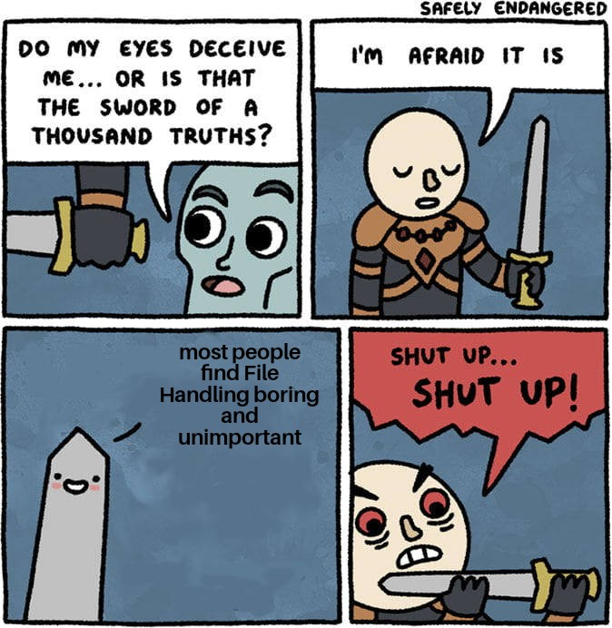

Slide 27

Thank you for PAYING attention in this free workshop.

